Slide 1
Part A: Introduction: Quality process of software (cont.)
Integrating quality activities in
the project life cycle (7/DG)
Reviews (8/DG)

Slide 2
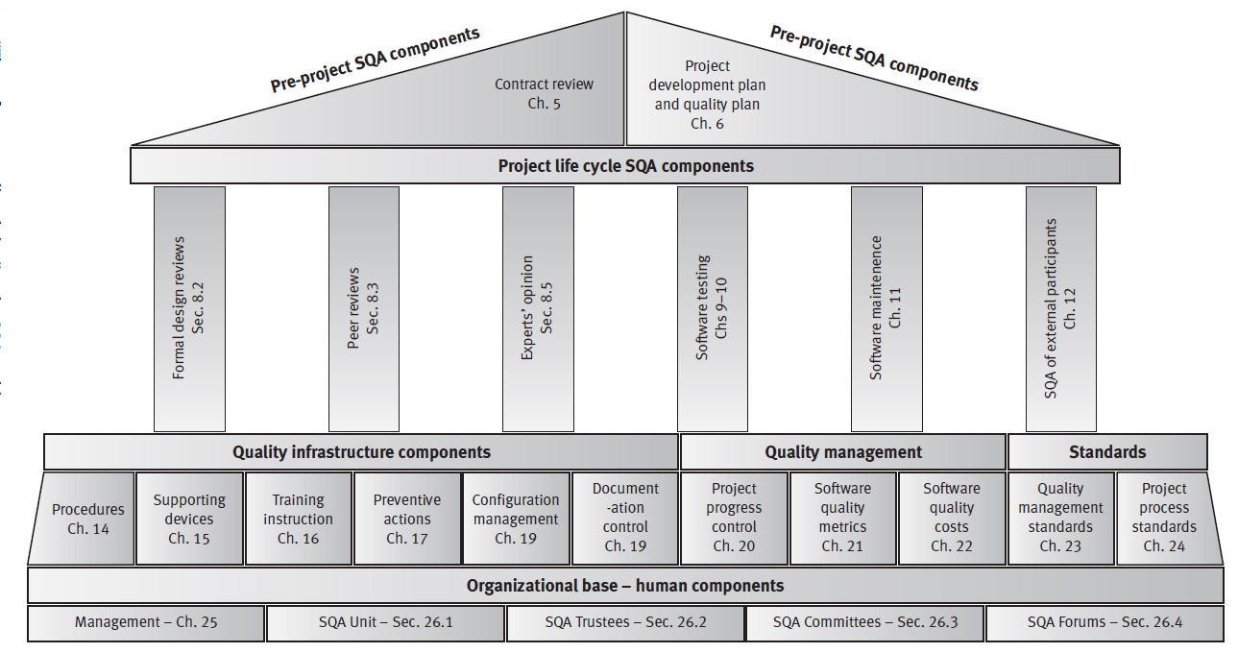
The SQA system – an SQA Architecture
The vision of D. Galin about the architecture

Slide 3
Integrating quality activities in the project life cycle
Presentation 7
Classic and other software development methodologies
Factors affecting intensity of quality assurance activities in the development process
Verification, validation and qualification
A model for SQA defect removal effectiveness and cost

Slide 4
1. Classic and other software development methodologies
Four models of the software development process are discussed in this section:
■ The Software Development Life Cycle (SDLC) model
■ The prototyping model
■ The spiral model
■ The object-oriented model.

Slide 5
Classic and other software development methodologies
■ The Software Development Life Cycle (SDLC) model
is the classic model (still applicable today); it provides the most comprehensive description of the process available.
is a linear sequential model that begins with requirements definition and ends with regular system operation and maintenance.

Slide 6
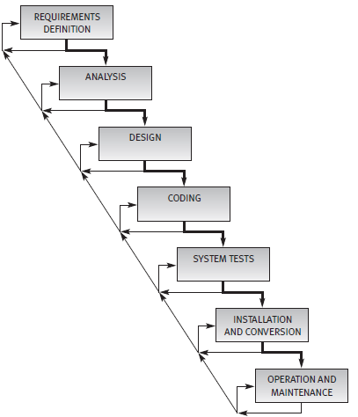
Classic and other software development methodologies
■ The Software Development Life Cycle (SDLC) model
The most common illustration of the SDLC model is the waterfall model
The waterfall model
Source: After Boehm (1981) and Royce (1970) (© 1970 IEEE)

Slide 7
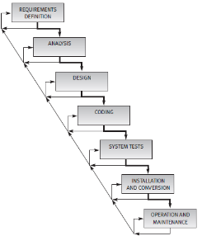
Classic and other software development methodologies
■ The Software Development Life Cycle (SDLC) model
System tests. System tests are performed once the coding phase is completed.
The main goal of testing is to uncover as many software errors as
possible so as to achieve an acceptable level of software quality once corrections have been completed.
System tests are carried out by the software developer before the software is supplied to the customer.

Slide 8
Classic and other software development methodologies
■ The Software Development Life Cycle (SDLC) model
System tests.
In many cases the customer performs independent software tests (“acceptance tests”).
It is quite common for a customer to ask the developer to join him or her in performing joint system tests, a procedure that saves
the time and resources required for separate acceptance tests

Slide 9
Classic and other software development methodologies
■ The Software Development Life Cycle (SDLC) model
In complex, large-scale models, some phases are split, causing their
number to grow to eight, nine or more.
In smaller projects, some phases may be merged, reducing the number of phases to six, five or even four phases.
At the end of each phase, the outputs are examined and evaluated by the developer and, in many cases, by the customer as well.

Slide 10
Classic and other software development methodologies
■The prototyping model
The prototyping methodology makes use of
developments in information technology, namely, advanced application generators that allow for fast and easy development of software prototypes,
combined with
b) active participation in the development process by customers and users capable of examining and evaluating prototypes.

Slide 11
Classic and other software development methodologies
■The prototyping model
The future users of the system are required to comment on the various versions of the software prototypes prepared by the developers.
In response to customer and user comments, the developers correct the prototype and add parts to the system on the way to presenting the next generation of the software for user evaluation.
This process is repeated till the prototyping goal is achieved or the software system is completed.

Slide 12
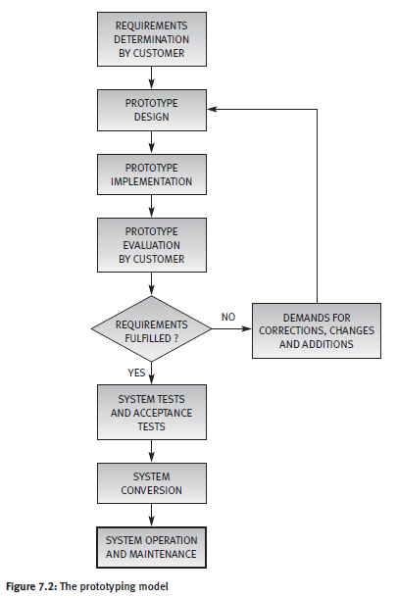
Classic and other software development methodologies
■The prototyping model

Slide 13
Classic and other software development methodologies
■ The spiral model (Boehm 1988, 1998),
… offers an improved methodology for overseeing large and more complex development projects displaying higher prospects for failure, typical of many projects begun in the last two decades.
It combines an iterative model that introduces and emphasizes
risk analysis and customer participation into the major elements of
SDLC and prototyping methodologies.

Slide 14
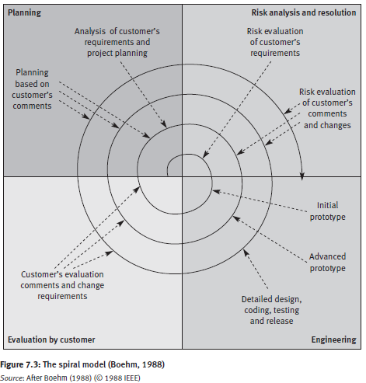








Classic and other software development methodologies
■ The spiral model (Boehm 1988, 1998),
… offers an improved methodology for overseeing large and more complex development projects displaying higher prospects for failure, typical of many projects begun in the last two decades.
It combines an iterative model that introduces and emphasizes
risk analysis and customer participation into the major elements of
SDLC and prototyping methodologies.

Slide 15
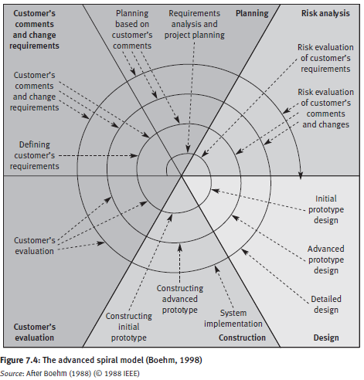






Classic and other software development methodologies
■ The spiral model (Boehm 1988, 1998),
Win – Win
Customer
--
Developer

Slide 16
Classic and other software development methodologies
■ The object-oriented model.
The object-oriented model differs from the other models by its intensive reuse of software components.
This methodology is characterized by its easy integration of existing software modules (called objects or components) into newly developed software systems.
A software component library serves this purpose by supplying software components for reuse.

Slide 17
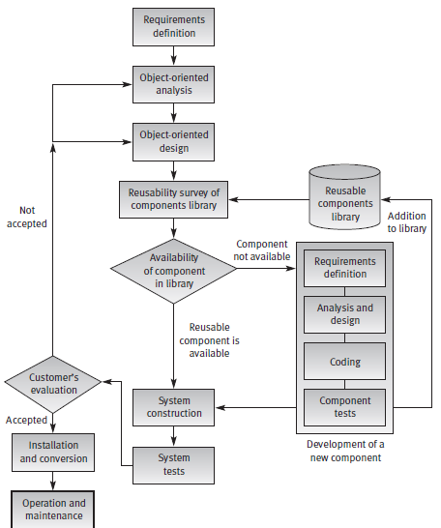




Classic and other software development methodologies
■ The object-oriented model.

Slide 18
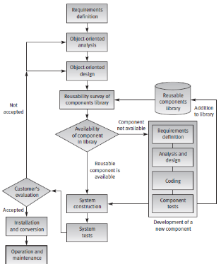

Classic and other software development methodologies
■ The object-oriented model.
Economy – The cost of integrating a reusable software component is
much lower than the cost of developing new components.
Improved quality – Used software components are expected to contain considerably fewer defects than newly developed software components due to detection of faults by former users.
Shorter development time – The integration of reusable software components reduces scheduling pressures.

Slide 19
2. Factors affecting intensity of quality assurance activities in the development process
Project factors and Team factors:
Project factors:
■ Magnitude of the project
■ Technical complexity and difficulty
■ Extent of reusable software components
■ Severity of failure outcomes if the project fails

Slide 20
Factors affecting intensity of quality assurance activities in the development process
Team factors:
■ Professional qualification of the team members
■ Team acquaintance/familiarity with the project and its experience in the area
■ Availability of staff members who can professionally support the team
■ Familiarity with the team members, in other words the percentage of new staff members in the team

Slide 21
3. Verification, validation and qualification
Three aspects of quality assurance of the software product (a report, code, etc.) are examined under the rubrics of verification, validation and qualification. IEEE Std 610.12-1990 (IEEE, 1990) defines these aspects as follows:

Slide 22

Verification, validation and qualification
“Verification – The process of evaluating a system or component to determine whether the products of a given development phase satisfy the conditions imposed at the start of that phase.” IEEE Std 610.12-1990 (IEEE, 1990)
Verification: Confirmation by examination and through provision of objective evidence that specified requirements have been fulfilled [ISO 9000].
Verification: Confirmation by examination and provision of objective evidence that the requirements have been fulfilled [IEC 61508-4] https://www.securecoding.cert.org/confluence/display/cplusplus/BB.+Definitions

Slide 23
Verification, validation and qualification
“Validation – The process of evaluating a system or component during or
at the end of the development process to determine whether it satisfies
specified requirements.” IEEE Std 610.12-1990 (IEEE, 1990)
Validation: Confirmation by examination and through provision of objective evidence that the requirements for a specific intended use or application have been fulfilled [ISO 9000].
Validation: Confirmation by examination and provision of objective evidence that the particular requirements for a specific intended use are fulfilled. [IEC 61508-4] https://www.securecoding.cert.org/confluence/display/cplusplus/BB.+Definitions

Slide 24
Verification, validation and qualification
IEEE Std 610.12-1990 (IEEE, 1990) defines these aspects as follows:
“Qualification – The process used to determine whether a system or component is suitable for operational use.”

Slide 25
4. Model for SQA defect removal effectiveness and cost
The model’s quantitative results:
a. The SQA plan’s total effectiveness in removing project defects
The total costs of removal of project defects

Slide 26
Defects originating
and defect removal costs
Software development phase | Average % of defects originating in phase | Average relative defect removal cost
Requirement specification | 15% | 1
Design | 35% | 2.5
Unit coding | 30% | 6.5
Integration coding | 10% | 16
Documentation | 10% | 40
System testing | ----- | 40
Operation | ----- | 110

Slide 27
Presentation 7
Integrating quality activities in
the project life cycle
Software development methodologies: - The software development life cycle (SDLC) model - The prototyping model - The spiral model - The object-oriented model
Factors affecting intensity of SQA activities
Verification, validation and qualification
Development and quality plans for small and for internal projects
A model for SQA defect removal effectiveness and cost

Slide 28
The prototyping model

Slide 29
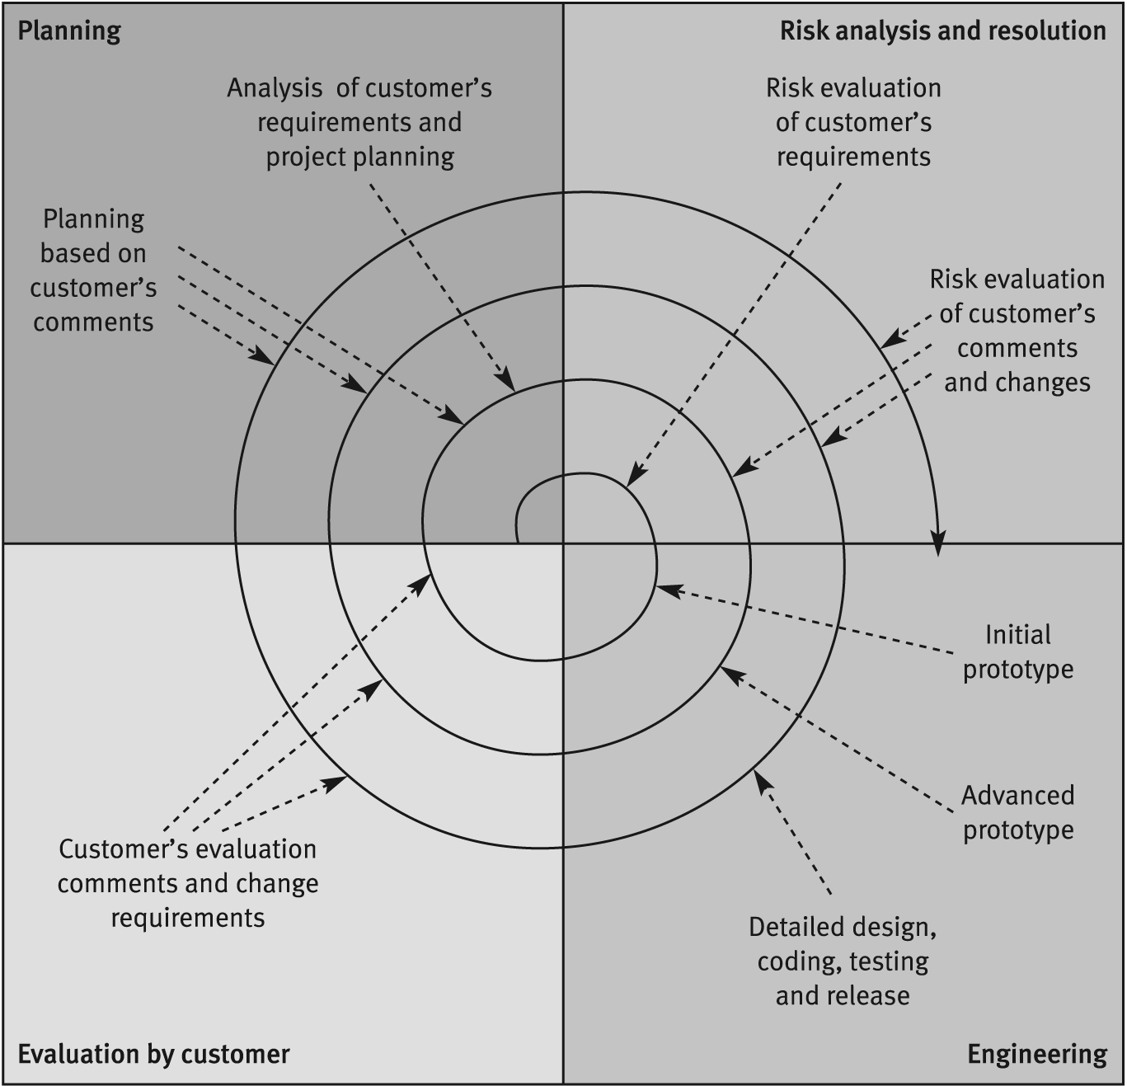
The Spiral Model
Source: After Boehm 1988 (© 1988 IEEE)

Slide 30
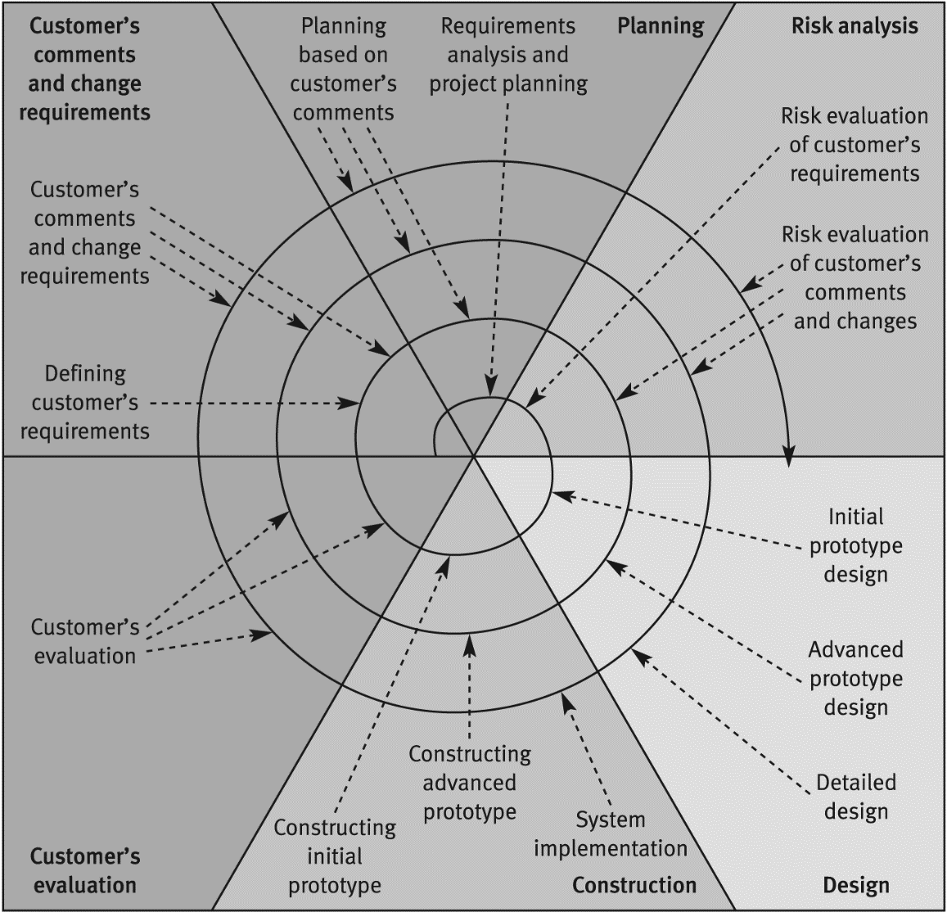
The Advanced
Spiral model The Win-Win Model
Source: After Boehm 1998 (© 1988 IEEE)

Slide 31
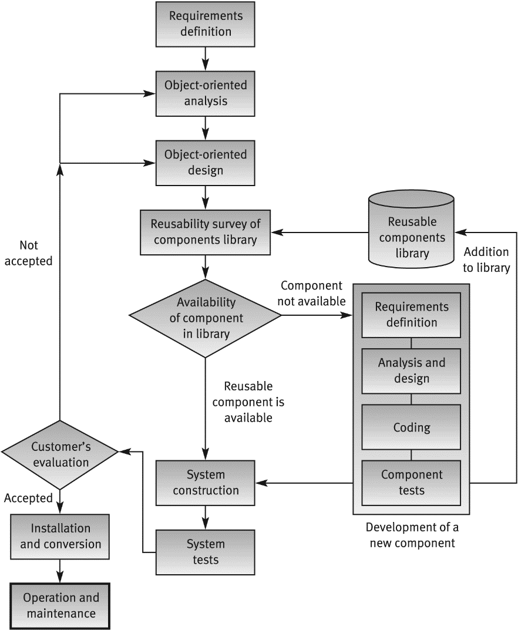
Object Oriented
Development Model

Slide 32
Factors affecting the required
intensity of SQA activities
Project factors:
Project’s magnitude
Project's technical complexity and difficulty
Extent of reusable software components
Severity of failure outcomes if the project fails
Team factors:
The professional qualification of the team members
Team acquaintance with the project and its experience in the area
Availability of staff members that can professionally support the team
Familiarity with the team members, in other words, the percentage of new staff members in the team

Slide 33
Verification, validation
and qualification
Verification – The process of evaluating a system or component to determine whether the products of a given development phase satisfy the conditions imposed at the start of that phase
Validation - The process of evaluating a system or component during or at the end of the development process to determine whether it satisfies specified requirements
Qualification - The process used to determine whether a system or component is suitable for operational use
IEEE Std 610.12-1990 (IEEE 1990)

Slide 34
Model for SQA defect removal
effectiveness and cost
The model’s quantitative results:
a. The SQA plan’s total effectiveness in removing project defects
b. The total costs of removal of project defects

Slide 35
Defects originating
and defect removal costs
Software development phase | Average % of defects originating in phase | Average relative defect removal cost
Requirement specification | 15% | 1
Design | 35% | 2.5
Unit coding | 30% | 6.5
Integration coding | 10% | 16
Documentation | 10% | 40
System testing | ----- | 40
Operation | ----- | 110

Slide 36
Defects removal effectiveness
for quality assurance plans
Quality assurance activity | Defects removal effectiveness for standard SQA plan | Defects removal effectiveness for comprehensive SQA plan
Specification requirement review | 50% | 60%
Design inspection | ----- | 70%
Design review | 50% | 60%
Code inspection | ----- | 70%
Unit test | 50% | 40%
Integration tests | 50% | 60%
Documentation review | 50% | 60%
System test | 50% | 60%
Opertion phase detection | 100% | 100%

Slide 37
Defects removal effectiveness
for quality assurance plans
Defect removal phase | Defect removal effectiveness | Average relative defect removal cost {cost unit}
 |  | Defect origination phase
 |  | Req | Des | Uni | Int | Doc
Requirement specification (Req) | 50% | 1 | --- | --- | --- | ---
Design (Des) | 50% | 2.5 | 1 | --- | --- | ---
Unit coding (Uni) | 50% | 6.5 | 2.6 | 1 | --- | ---
Integration (Int) System documentation (Doc) | 50% 50% | 16 16 | 6.4 6.4 | 2.5 2.5 | 1 | 1
System testing / Acceptance testing (Sys) | 50% | 40 | 16 | 6.2 | 2.5 | 1
Opertion by customer (after release) | 100% | 110 | 44 | 17 | 6.9 | 2.5

Slide 38
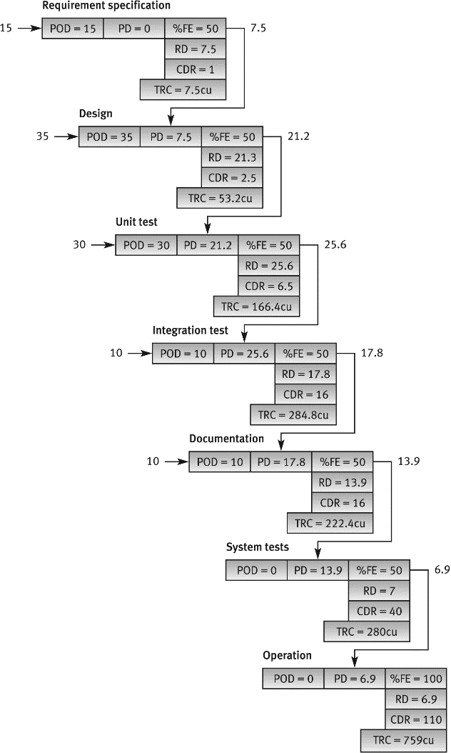
The standard quality assurance plan
The process of removing 100 defects
· POD = Phase Originated Defects
· PD = Passed Defects (from former phase or former quality assurance activity)
· %FE = % of Filtering Effectiveness (also termed % screening effectiveness)
· RD = Removed Defects
· CDR = Cost of Defect Removal
· TRC = Total Removal Cost. TRC = RD x CDR.

Slide 39
Defect correction effectiveness
and cost - standard
plan model of the process of
correction 100 defects
Slide 7.12a – relates to updated section 7.4
Req, specification
(POD=15)
 | Ddoc | Dint | Duni | Ddes | Dreq | Total
ID |  |  |  |  | 15 | 15
PD |  |  |  |  | 7.5 | 7.5 | %FE=50
RD |  |  |  |  | 7.5 | 7.5
RDRC |  |  |  |  | 1 | TRC > | 7.5 cu
7.5
 | Ddoc | Dint | Duni | Ddes | Dreq | Total
ID |  |  |  | 35 | 7.5 | 42.5
PD |  |  |  | 17.5 | 3.8 | 21.3 | %FE=50
RD |  |  |  | 17.5 | 3.7 | 21.2
RDRC |  |  |  | 1 | 2.5 | TRC > | 26.8 cu
 | Ddoc | Dint | Duni | Ddes | Dreq | Total
ID | 10 | 5 | 7.5 | 4.4 | 1.0 | 27.9
PD | 5 | 2.5 | 3.8 | 2.2 | 0.5 | 14.0 | %FE=50
RD | 5 | 2.5 | 3.7 | 2.2 | 0.5 | 13.9
RDRC | 1 | 1 | 2.5 | 6.4 | 16 | TRC > | 38.9 cu
Documentation
reviews (POD=10)
Design
(POD=35)
21.3
14.0
 | Ddoc | Dint | Duni | Ddes | Dreq | Total
ID |  |  | 30 | 17.5 | 3.8 | 51.3
PD |  |  | 15 | 8.8 | 1.9 | 25.7 | %FE=50
RD |  |  | 15 | 8.7 | 1.9 | 25.6
RDRC |  |  | 1 | 2.6 | 6.5 | TRC > | 50 cu
 | Ddoc | Dint | Duni | Ddes | Dreq | Total
ID | 5 | 2.5 | 3.8 | 2.2 | 0.5 | 14.0
PD | 2.5 | 1.2 | 1.9 | 1.1 | 0.3 | 7.0 | %FE=50
RD | 2.5 | 1.3 | 1.9 | 1.1 | 0.2 | 7.0
RDRC | 2.5 | 2.5 | 6.2 | 1.6 | 40 | TRC > | 50.9 cu
Unit tests
(POD=30)
System tests
(POD=0)
25.7
7.0
Operation by
customer (POD=0)
Integration tests
(POD=10)
 | Ddoc | Dint | Duni | Ddes | Dreq | Total
ID |  | 10 | 15 | 8.8 | 1.9 | 35.7
PD |  | 5 | 7.5 | 4.4 | 1.0 | 17.9 | %FE=50
RD |  | 5 | 7.5 | 4.4 | 0.9 | 17.8
RDRC |  | 1 | 2.5 | 6.4 | 1.6 | TRC > | 66.3 cu
 | Ddoc | Dint | Duni | Ddes | Dreq | Total
ID | 2.5 | 1.2 | 1.9 | 1.1 | 0.3 | 7.0
PD | 0 | 0 | 0 | 0 | 0 | 0 | %FE=50
RD | 2.5 | 1.2 | 1.9 | 1.1 | 0.3 | 7.0
RDRC | 6.9 | 6.9 | 17 | 44 | 110 | TRC > | 139.2 cu
17.9

Slide 40
Presentation 8
Reviews
1. Review objectives
2. Formal design reviews (DRs)
3. Peer reviews
4. A comparison of the team review methods
5. Expert opinions

Slide 41
1. Review objectives
Several methodologies can be implemented when reviewing documents.
In this chapter, the following methods will be discussed:
■ Formal design reviews
■ Peer reviews (inspections and walkthroughs)
■ Expert opinions.
Standards for software reviews are the subject of IEEE Std 1028 (IEEE, 1997-2008) ( http://eitbokwiki.org/Key_Standards ).

Slide 42



IEEE Standard for Software
Reviews
IEEE Std 1028-2008
15 August 2008
Revision of IEEE Std 1028-1997
Content
1. Purpose
2.
Application Intent
3. Application
4. Conformance
5. Organization
6.
Types of Reviews
7. Differences between types of reviews
11/24/2009
2
IEEE- Standard for Software Reviews

Slide 43
Systematic Software Reviews
• The standard provides minimum
acceptable
requirements for systematic
reviews:
– Team participation
– Documented results of the review
– Documented procedures for conducting the review
• The standard is not
intended to discourage
or
prohibit
the use of non-systematic
reviews
11/24/2009
3
Purpose and Scope
•
The standard defines how to
carry out a review
•
Five types
of reviews are described
1.
Management Reviews
2.
Technical Reviews
3.
Inspections
4.
Walk-through
•
5.
Audits
Defines procedures
for the execution of each review type
•
The standard does not
define
– The
–
need
to conduct specific reviews
Procedures for determining the necessity
for a review
–
•
Defined in other standards, e.g. IEEE, ISO standard
Disposition
of the results
11/24/2009
4
IEEE- Standard for Software Reviews

Slide 44
Application Intent
1.
Standard applies throughout the scope of any
software life-
cycle model
2.
Maximum benefit by planning
them early
in the project life
cycle
3.
Can be used where software
is the total system
or when it is
part
of a larger system
4.
Software reviews should exist in concert
with hardware
and
system
reviews
5.
May include both personnel
internal to the project and
customer
or acquirer
and subcontractor
(s)
11/24/2009
5
Conformance
•
Conformance is claimed when all
mandatory actions
(i.e. shall) are carried out as defined in the standard
– Shall
: express a requirement
–
Should: express a recommendation
–
May: express alternative or optional methods
•
Claim for conformance should indicate the review type
used
–
e.g. conforming to IEEE Std 1028-2008 for Inspections
11/24/2009
6
IEEE- Standard for Software Reviews

Slide 45
Organization of the Standard
1. Introduction
–
Describes the objectives and overview of type of reviews
2. Responsibilities
3.
4.
Input needed to perform a review
Entry Criteria
–
Criteria to be met before review can begin
5.
•
e.g. authorization, initiating event
Procedures:
•
e.g. planning, overview, preparation, examination,
evaluation, recording, rework, follow-up
6.
Exit criteria
7. Output
11/24/2009
7
Application of the Standard
•
Software
1.
Acquisition
, i.e. an organization that acquires a system
2. Supply
, i.e. an organization that provides a system to the
acquirer
3. Development
4. Operation
, i.e. an organization that defines, develops
5.
Maintenance
•
Software Products (37 are listed in the standard)
–
e.g. reports, procedures, contracts, plans, manuals, code,
complaints, report data , inspection records.
•
Reviews can be conducted by many means
–
e.g. telephone or video conference, group communication
11/24/2009
8
IEEE- Standard for Software Reviews

Slide 46
Definitions
•
–
Anomaly
Any condition that deviates
from expectations based on specifications
,
•
standards, etc.
–
Review
A process or meeting where a software product is presented
comments or approval
for
•
–
Management Review
Under the leadership
of management
–
A systematic
evaluation
of a software
process
•
e.g. development process, acquisition process
–
Performed by or on behalf
of management to:
1.
Monitor progress
2.
Determine status
of plans and schedules
3. Confirm
requirements and their system allocation
4. Evaluate
effectiveness of management approaches
11/24/2009
9
Technical Review
•
Under the leadership
of the lead engineer
•
A systematic
evaluation
of a software product
•
By a team of qualified
personnel to provide management
with evidence to confirm:
1.
The suitability
of the product for its intended use
2. The product adheres
to regulations, plans,
specifications and standards
3. Changes
and affect only
those system areas identified by the change
specification
May provide recommendations
are properly implemented
•
of alternatives or
examination
of alternatives to management
11/24/2009
10
IEEE- Standard for Software Reviews

Slide 47
Technical Review
•
Responsibilities
– Roles
that shall
be established
•
Decision maker, Review leader, Recorder, Technical staff.
– Roles that may
be established
•
•
Management staff, other tea members, customer or user rep.
Input
–
Statement of objectives, software product, plan, anomalies, review
procedures
•
Entry criteria
– Authorization
•
Need shall be defined by project planning documents
•
At the request
of management, SQA, system engineering according to
local procedures.
– Tech review may be used to evaluate impacts of hardware anomalies
or deficiencies on software
– Preconditions
• Statement of objectives
for the review
• Review
inputs
are available
11/24/2009
11
•
Procedure
Technical Reviews
1.
2.
3.
4.
5.
Management preparation (plan, resources, funding, training, etc.)
Planning the review (by review leader)
Overview of review procedure (when requested by review leader)
Overview of the software product (when requested by review leader)
Preparation (prior to
examination meeting
–
–
)
Examine the product, anomalies sent to leader, to author for disposition
Leader gather preparation time and reschedule if appropriate.
6.
Examination (meeting)
1.
2.
3.
Decide on agenda
Evaluate product
Determine if:
•
•
Product is complete, conforms, properly implemented, suitable for use
Changes to the software product are properly implemented and affect only the
•
specified areas;
•
The software product is suitable for its intended use;
The software product is ready for the next activity
Hardware anomalies
;
4.
5.
6.
•
or specification discrepancies exist
Identify anomalies
Generate list of action items
Document the meeting (leader may recommend additional review)
7.
Rework/Follow-up
–
Leader shall verify that action items
are closed
11/24/2009
12
IEEE- Standard for Software Reviews

Slide 48
Technical Reviews
•
Exit criteria
– Review is competed when activities are accomplished
and output exists
Output
– Documented evidence that identifies:
•
• Project reviewed
• Team members
• Product reviewed
•
Inputs to review
• Review objectives
•
•
•
•
List of resolved and unresolved software anomalies
List of resolved and unresolved hardware anomalies
List of managerial issues
Action items status ( open, closed), ownership, target date
• Any recommendations
•
Whether product reviewed meets regulations, standards, etc.
11/24/2009
13
Walk-through
– A
static analysis
technique of a software product
–
Where participants
1.
ask questions and make comments
2. Find anomalies
3. Improve
the product
4.
Consider alternative
implementations
5.
Evaluate conformance
to standards or specifications
•
•
Defined Roles
–
Leader, recorder, author, team member
Management position ‘over’ participants shall not
participate
–
May be held to educate
an audience about a software
11/24/2009
product
14
IEEE- Standard for Software Reviews

Slide 49

Inspection
1.
A visual examination
of a software product to detect and
identify anomalies
including errors and deviations from
standards and specifications.
2. Peer examined
, led by impartial and trained facilitators
3. Determination of remedial
or investigative action
for an
anomaly is mandatory
4. Solutions
are not
determined during inspection meeting
5.
Management position ‘over’ participants shall not
participate.
6. Collection and analysis of data
is strongly recommended
11/24/2009
15
Focus of Types of Reviews
Technical
Review
Decision
Making
Understanding
Walk-through
Defect
Removal
Inspection
11/24/2009
Source: Gilb & Graham, Inspection Course notes, Sept 1995.
16
16
IEEE- Standard for Software Reviews

Slide 50
Audits
•
Purpose
–
To provide an independent
evaluation of conformance
of software
products
and processes
to applicable regulations
, standards
, guidelines
plans
, and procedures
,
.
•
Examples of software products
subject to audit include:
–
Software configuration management plans
, Software design
descriptions, Installation procedures
, Source code, Unit development
folders, Software test documentation, Walk-through reports
•
Examination
,…
–
Examination shall consist of evidence collection and analysis
with
respect to the audit criteria
between the auditors and
audited organization, and preparing an audit report
, a closing meeting
.
•
Evidence collection
–
The auditors shall collect evidence
of conformance
and non-
conformance
by interviewing
audited organization staff, examining
documents, and witnessing
processes.
11/24/2009
17
Audits
•
Examples of non-conformance
– Applicable
regulations, standards, guidelines, plans, and procedures
not used at all
– Applicable
regulations, standards, guidelines, plans, and procedures
not used correctly
•
Observations
–
An observation should be classified as major
if the non-conformity
will likely have a significant effect
on product quality, project cost,
–
or project schedule.
All observations shall be verified
by discussing them with the audited
organization
before
the closing audit meeting.
11/24/2009
18
IEEE- Standard for Software Reviews

Slide 51
Audits
•
Content of Audit Report
of the audit
2. Audited organization
1.
Purpose and scope
, including location, liaison staff, and
management
3. Identification
audited
4. Applicable regulations, standards, guidelines, plans, and procedures
used for evaluation
of the software products
5. Evaluation criteria
6.
7.
8.
9.
Summary of auditor’s organization
Summary of examination activities
Summary of the planned examination activities not performed
Observation list, classified as major or minor
10. A summary and interpretation of the audit findings including the key
items of non-conformance
11. The type and timing of audit follow-up activities
•
When stipulated by the audit plan, recommendations
shall be provided
11/24/2009
19
Review Differences
Management
Review
Ensure
Progress
Technical
Review
Evaluate
Inspection
Walk-through
Audit
Objective
Conformances*
Find Anomalies
Find Anomalies
Examine/Improve
Evaluate
Number of
Members
Unlimited
3-6
2-7
Compliance**
1-5
Material Size
Moderate
to High
Relatively
Low
Moderate to
High
Leadership
Manager
Lead Eng.
Trained
Facilitator
Facilitator or
Author
Lead Auditor
Management
Present ?
Volume of
material
Yes
Optional
No
No
Yes
Moderate to
High
Moderate to
High
Low
Low
Moderate to
High
Checklist ?
No
No
Yes
No
Yes
Output list
Management
report
Technical report
Defect list
Report
Defect
(Audit report)
* To specifications ** to standards
11/24/2009
20
IEEE- Standard for Software Reviews

Slide 52
Review Differences
Characteristic
Management review
Technical review
Inspections
Walk-through
Audit
Presenter
Project representative
Development
Team representative
A reader
Author
Auditors collect and
examine information
provided by audited
organization
Data collection
As required by applicable Not a formal project
Strongly
recommended
Recommended
Not a formal project
requirement.
May be done locally.
Output
policies, standards, or
plans
requirement.
May be done locally.
Anomaly list, action
items, decision,
follow up proposal
Management review
Documentation
Technical review
documentation
Anomaly list,
anomaly
summary,
inspection
documentation
Formal audit report
observation, feeding
deficiencies
Formal
facilitator
training
No
No
Yes
No
Yes (formal
training)
auditing
Defined
participants roles
Yes
Yes
Yes
Yes
Yes
Use of defect
checklists
No
No
Yes
No
Yes
Management
participates
Yes
Optional
No
No
Yes
Customer or user Optional Optional Optional Optional Optional
representative
participates
11/24/2009
21
IEEE- Standard for Software Reviews

Slide 53
Review objectives
Several objectives motivate reviews.
The review’s direct objectives deal with the current project,
whereas
its indirect objectives, more general in nature, deal with the contribution of the review proper → to the promotion of team
members’ professional knowledge and the improvement of the development methodologies applied by the organization.
Notes:
review proper (reviyuire adecvată/corespunzătoare)

Slide 54
Review objectives
Direct objectives
■ To detect analysis and design errors … with respect to the original specifications and approved changes.
■ To identify new risks likely to affect completion of the project.
■ To locate deviations from templates and style procedures and conventions.
■ To approve the analysis or design product. Approval allows the team to continue to the next development phase.

Slide 55
Review objectives
Indirect objectives
■ To provide an informal meeting place for exchange of professional
knowledge about development methods, tools and techniques.
■ To record analysis and design errors that will serve as a basis for future
corrective actions.
The corrective actions are expected to improve development methods by increasing effectiveness and quality, among other product features.

Slide 56
Review objectives
Reviews are not activities to be conducted haphazardly.
Procedural order and teamwork lie at the heart of formal design reviews, inspections and walkthroughs.
At each review session, one individual is assigned the task of inscribing mutually agreed remarks.
The subsequent list of items should include full details of defect location and description, documented in a way that will later allow full retrieval by the development team.
Notes:
Procedural order = ordinea procedurala

Slide 57
2. Formal design reviews
Formal design reviews,
variously called “design reviews”, “DRs” and “formal technical reviews (FTR)”,
differ from all other review instruments by being the only reviews that are necessary for approval of the design product.
Without this approval, the development team cannot continue to the next phase of the software development project.

Slide 58
Formal design reviews
Some common formal design reviews
DPR – Development Plan Review
SRSR – Software Requirement Specification Review
PDR – Preliminary Design Review
DDR – Detailed Design Review
DBDR – Data Base Design Review
TPR – Test Plan Review
STPR – Software Test Procedure Review
VDR – Version Description Review
OMR – Operator Manual Review
SMR – Support Manual Review
TRR – Test Readiness Review
PRR – Product Release Review
IPR – Installation Plan Review

Slide 59
Formal design reviews
8.2.1 The participants in a DR
All DRs are conducted by
a review leader
and
a review team.
The choice of appropriate participants is of special importance because of their power to approve or disapprove a design product.

Slide 60
Formal design reviews
8.2.2 Preparations for a DR
The preparations for a DR session are to be completed by all three main participants in the review –
the review leader,
the review team, and
the development team
because – each participant is required to focus on distinct aspects of the process.

Slide 61
Formal design reviews
8.2.2 Preparations for a DR
Review leader preparations
The main tasks of the review leader in the preparation stage are:
■ To appoint the team members
■ To schedule the review sessions
■ To distribute the design document among the team members (hard copy, electronic file, etc.).

Slide 62
Formal design reviews
8.2.2 Preparations for a DR
Review team preparations
Team members are expected to review the design document and list their comments prior to the review session.
In cases where the documents are sizable, the review leader may ease the load by assigning to each team member review of only part of the document.
An important tool for ensuring the review’s completeness is the checklist.

Slide 63
Formal design reviews
8.2.2 Preparations for a DR
Development team preparations
The team’s main obligation as the review session approaches is to prepare a short presentation of the design document.
Assuming that the review team members have read the design document thoroughly and are now familiar with the project’s outlines, the presentation should focus on the main professional issues awaiting approval rather than wasting time on description of the project in general.

Slide 64
Formal design reviews
8.2.3 The DR session
The review leader’s experience in leading the discussions and sticking to the agenda is the key to a successful DR session.

Slide 65
Formal design reviews
8.2.3 The DR session
A typical DR session agenda includes:
(1) A short presentation of the design document.
(2) Comments made by members of the review team.
(3) Verification and validation in which each of the comments is discussed to determine the required actions (corrections, changes and additions) that the project team has to perform.
(4) Decisions about the design product (document), which determines the project’s progress.

Slide 66
Formal design reviews
8.2.3 The DR session
These decisions can take three forms:
■ Full approval – enables immediate continuation to the next phase
of the project. full approval may be accompanied by demands for some minor corrections to be performed.
■ Partial approval – approval of immediate continuation to the next
phase for some parts of the project, with major action items (corrections, changes and additions) demanded for the remainder of the project.
■ Denial of approval – demands a repeat of the DR.

Slide 67
Formal design reviews
8.2.4 Post-review activities
The DR report:
Is the one of the review leader’s responsibilities. The major sections ..:
■ A summary of the review discussions.
■ The decision about continuation of the project.
■ A full list of the required actions – corrections, changes and additions that the project team has to perform.
■ The name(s) of the review team member(s) assigned to follow up performance of corrections.

Slide 68
Formal design reviews
8.2.4 Post-review activities
The follow-up process
The person appointed to follow up the corrections, in many cases the review leader him or herself, is required to determine whether each action item has been satisfactorily accomplished as a condition for allowing the project to continue to the next phase.
Follow-up should be fully documented to enable clarification of the corrections in the future, if necessary.

Slide 69
3. Peer reviews
The principles and process of design peer reviews can also be successfully applied to code peer reviews:
1. Participants of peer reviews
2. Preparations for a peer review session
3. The peer review session
4. Post-peer review activities
5. The efficiency of peer reviews
6. Peer review coverage

Slide 70
Peer reviews
1. Participants of peer reviews
The optimal peer review team is composed of three to five participants.
All the participants should be peers of the software system designer-author.
A recommended peer review team includes:
■ A review leader
■ The author
■ Specialized professionals.

Slide 71
Peer reviews
1. Participants of peer reviews
■ A review leader
The role of review leader (“moderator” in inspections, “coordinator’ in
walkthroughs) differs only slightly by peer review type.
■ The author
The author is, invariably a participant in each type of peer review.

Slide 72
Peer reviews
1. Participants of peer reviews
■ Specialized professionals. The specialized professionals participating in the two peer review methods differ by review.
For inspections:
A designer;
A coder or implementer;
A tester;
For walkthroughs
A standards enforcer;
A maintenance expert;
A user representative.

Slide 73
Peer reviews
1. Participants of peer reviews
What is walkthroughs? (http://istqbexamcertification.com/what-is-walkthrough-in-software-testing/
a pedestrian passageway or arcade through the ground floor of a building connecting one street or building with another)
■ It is not a formal process/review
■ It is led by the authors
■ Author guide the participants through the document according to his or her thought process to achieve a common understanding and to gather feedback.
■ Useful for the people if they are not from the software discipline, who are not used to or cannot easily understand software development process.
■ Is especially useful for higher level documents like requirement specification, etc.

Slide 74
Peer reviews
1. Participants of peer reviews
Team assignments: Conducting a review session requires, naturally, assignment of specific tasks to the team members.
Two of these members are:
the presenter of the document: During inspection sessions, the presenter of the document is chosen by the moderator, but not the document’s author. The software coder - understand the design logic and its implications for coding. For most walkthrough sessions, it is the author, the professional most intimately acquainted with the document.
the scribe.

Slide 75
Peer reviews
1. Participants of peer reviews
Team assignments:
Two of these members are:
the presenter of the document:
and
the scribe.The team leader will often – but not always – serve as the scribe for the session, and record the noted defects that are to be corrected by the development team.

Slide 76
Peer reviews
2. Preparations for a peer review session
The review leader and the team members are to assiduously complete their preparation, with the type of review determining their scope.
Peer review leader’s preparations for the review session
To determine, together with the author, which sections of the design document are to be reviewed
To select the team members.
To schedule the peer review sessions
To distribute the document to the team members
Peer review team’s preparations for the review session
The preparations required of an inspection team member are quite thorough, while those required of a walkthrough team member are brief.
Prior to the walkthrough session, team members briefly read the material in order to obtain a general overview of the sections to be reviewed, the project and its environment.

Slide 77
Peer reviews
3. The peer review session
The presenter reads a section of the document and adds, if needed, a brief explanation of the issues involved in his or her own words.
As the session progresses, the participants either deliver their comments to the document or address their reactions to the comments.
The discussion should be confined to identification of errors, which means that it should not deal with tentative solutions.

Slide 78
Peer reviews
3. The peer review session
The agenda of the typical walkthrough session opens with the author’s short presentation or overview of the project and the design sections to be reviewed.
During the session, the scribe should document each error recognized by location and description, type and character (incorrect, missing parts or extra parts).
The inspection session scribe will add the estimated severity of each
defect, a factor to be used in the statistical analysis of defects found and for the formulation of preventive and corrective actions.
Sessions should not exceed two hours in length, or schedule for more than twice daily.

Slide 79
Peer reviews
3. The peer review session
Session documentation
Two documents are to be produced following an inspection session and
subsequently distributed among the session participants.
Inspection session findings report: The Scribe
Inspection session summary report: The Inspection leader
At the end of a session or series of walkthrough sessions, copies of the error
documentation – the “walkthrough session findings report” – should be
handed to the development team and the session participants.

Slide 80
Peer reviews
4. Post-peer review activities
The inspection process, contrary to the walkthrough, does not end with a review session or the distribution of reports. Post-inspection activities are conducted to attest to:
■ The prompt, effective correction and reworking of all errors by the
designer/author and his team, as performed by the inspection leader (or other team member) in the course of the assigned follow-up activities.
■ Transmission of the inspection reports to the internal Corrective Action Board (CAB) for analysis. This action initiates the corrective and preventive actions that will reduce future defects and improve productivity.

Slide 81
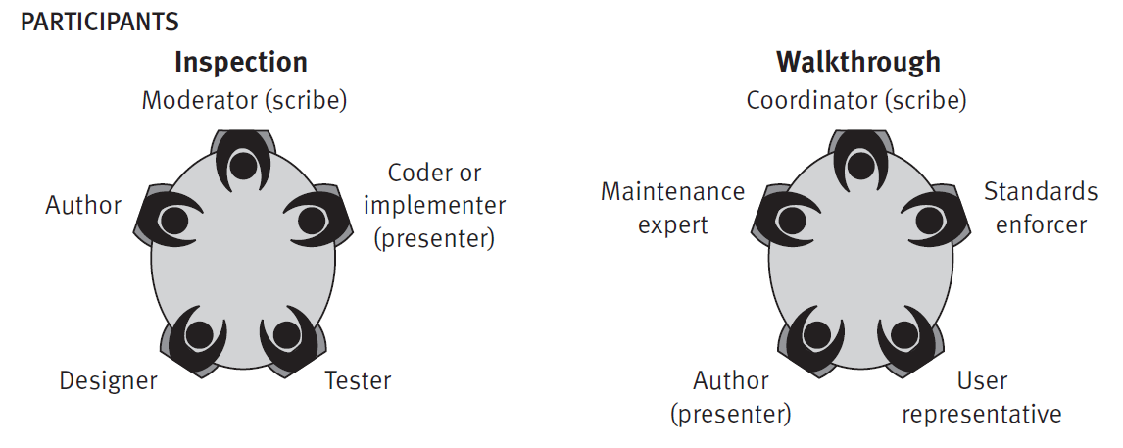
Peer reviews
Ghjhgjgjhg

Slide 82
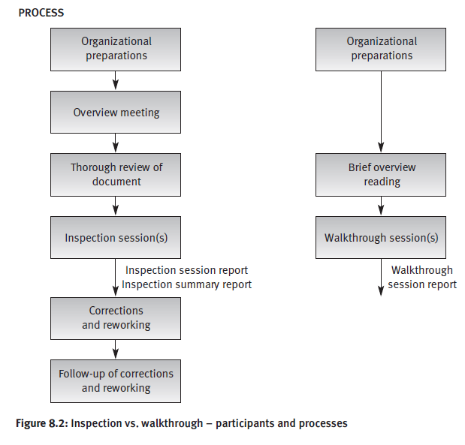
Peer reviews
Ghjhgjgjhg

Slide 83
…
The efficiency of peer reviews
…
Peer review coverage
…
A comparison of the team review methods

Slide 84
8.5 Expert opinions
Expert opinions, prepared by outside experts, support quality evaluation by introducing additional capabilities to the internal review staff.
The organization’s internal quality assurance activities are thereby reinforced.
Outside experts transmit their expertise by either:
■ Preparing an expert’s judgement about a document or a code section.
■ Participating as a member of an internal design review, inspection or walkthrough team.

Slide 85
8.5 Expert opinions
An outside expert’s judgement as well as his or her participation as an external member of a review team is most beneficial in the following situations:
■ Insufficient in-house professional capabilities in a specialized area.
■ Temporary lack of in-house professionals for review team participation due to intense workload pressures during periods when waiting will cause substantial delays in the project completion schedule.
■ Indecisiveness caused by major disagreements among the organization’s senior professionals.
■ In small organizations, where the number of suitable candidates for a review team is insufficient.

Slide 86
Presentation 8
Reviews
Review objectives
Formal design reviews (FDRs)
Participants
Preparations
The FDR session
Post-review activities
Peer reviews (inspections and walkthroughs)
Participants
Preparations
The FDR session
Post-review activities
Peer review coverage
Comparison of peer reviews methods
Expert opinions

Slide 87
Review objectives
Direct objectives
a. To detect analysis and design errors as well as subjects where corrections, changes and completions are required
b. To identify new risks likely to affect the project.
c. To locate deviations from templates, style procedures and conventions.
d. To approve the analysis or design product. Approval
allows the team to continue on to the next development phase. Indirect objectives
a. To provide an informal meeting place for exchange of professional knowledge about methods, tools and techniques.
b. To record analysis and design errors that will serve as a basis for future corrective actions.

Slide 88
Some common formal
design reviews (DRs)
DPR – Development Plan Review
SRSR – Software Requirement Specification Review
PDR – Preliminary Design Review
DDR – Detailed Design Review
DBDR – Data Base Design Review
TPR – Test Plan Review
STPR – Software Test Procedure Review
VDR – Version Description Review
OMR – Operator Manual Review
SMR – Support Manual Review
TRR – Test Readiness Review
PRR – Product Release Review
IPR – Installation Plan Review

Slide 89
Characteristics of a DR leader
* Knowledge and experience in development of projects of the type reviewed. Preliminary acquaintance with the current project is not necessary.
* Seniority at a level similar if not higher than that of the project leader.
* A good relationship with the project leader and his team.
* A position external the project team

Slide 90
The Agenda of a DR session
a. A short presentation of the design document.
b. Comments made by members of the review team.
c. Verification and validation of comments is discussed to determine the required action items (corrections, changes and additions).
d. Decisions about the design product (document), which determines the project's progress:
· Full approval.
· Partial approval.
· Denial of approval.

Slide 91
DR post-review activities
a. Preparation of the DR report.
The report's major sections:
· A summary of the review discussions.
· The decision about continuation of the project.
· A full list of the required action items — corrections, changes and additions. For each action item, completion date and project team member responsible are listed.
· The name(s) of the review team member(s) assigned to follow up.
b. Follow up performance of the corrections and to examine the corrected sections.

Slide 92
Pressman's 13 golden guidelines
for successful DR - 1
Design Review Infrastructure
· Develop checklists for common types of design documents.
· Train senior professionals serve as a reservoir for DR teams.
· Periodically analyze past DR effectiveness.
· Schedule the DRs as part of the project plan.
The Design Review Team
. Review teams size should be limited, with 3–5 members being the optimum.

Slide 93
Pressman's 13 golden
guidelines for successful DR - 2
The Design Review Session
Discuss professional issues in a constructive way refraining from personalizing the issues.
Keep to the review agenda.
Focus on detection of defects by verifying and validating the participants' comments. Refrain from discussing possible solutions.
In cases of disagreement about an error - end the debate by noting the issue and shifting its discussion to another forum.
Properly document the discussed comments, and the results of their verification and validation.
The duration of a review session should not exceed two hours.
Post-Review Activities
Prepare the review report, including the action items
Establish follow-up to ensure the satisfactory performance of all the list of action items

Slide 94
Participants of peer reviews
Inspection
Walkthrough
Review leader
The author
Specialized professionals:
Designer
Coder or implementer
Tester
Review leader
The author
Specialized professionals:
Standards enforcer
Maintenance expert
User representative

Slide 95
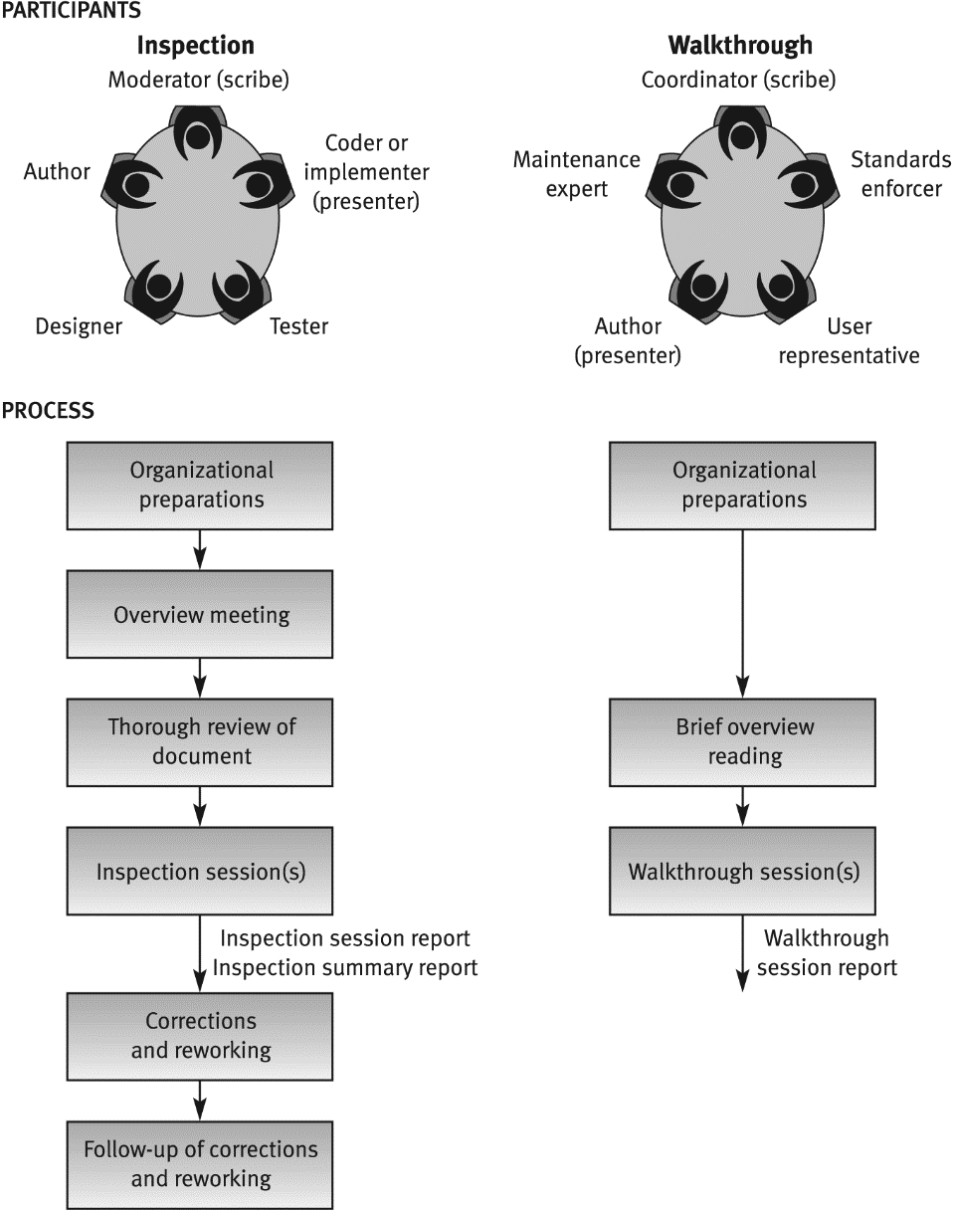
Inspection vs. Walkthrough

Slide 96
Code inspection effectiveness
at Fujitso (Cusumano)
Year
Defect detection method
Defects per 1000 lines of maintained code
Test
%
Design review
%
Code inspection
%
1977
85
---
15
0.19
1978
80
5
15
0.13
1979
70
10
20
0.06
1980
60
15
25
0.05
1981
40
30
30
0.04
1982
30
40
30
0.02

Slide 97
Sections recommended to be
included in or omitted from
peer reviews
Sections recommended for inclusion
Sections of complicated logic
Critical sections, where defects severely damage essential system capability
Sections dealing with new environments
Sections designed by new or inexperienced team members
Sections recommended for omission
“Straightforward” sections (no complications)
Sections of a type already reviewed by the team in similar past projects
Sections that, if faulty, are not expected to effect functionality
Reused design and code
Repeated parts of the design and code

Slide 98
Comparison of review
methodologies -
Process of review
Properties | Design review | Inspection | Walkthrough
Overview meeting | No | Yes | No
Participant’s preparations | Yes - thorough | Yes - thorough | Yes - brief
Review session | Yes | Yes | Yes
Follow-up of corrections | Yes | Yes | No
Formal training of participants | No | Yes | No
Participant’s use of checklists | No | Yes | No
Error-related data collection | Not formally required | Formally required | Not formally required
Review documentation | Formal design review report | 1) Inspection session findings report 2) Inspection session summary report

Slide 99
Situations beneficial for expert's
participation in reviews
· Insufficient in-house professional capabilities in a specialized area.
· Temporary lack of in-house professionals for review team.
· Indecisiveness caused by major disagreements among the organization’s senior professionals.
· In small organizations, where the number of suitable candidates for a review team is insufficient.

